Slide 1
Client-Server Chat
Group 2

Slide 2
Contributions
Ziegfried Flameno – Base Classes, File Transactions, General Debugging, Test Cases
Lance Lopez – Chat (Chat Server-Client)
Kassandra Fuentes – UML Diagram, Register, Login, Test Cases
William Kalingasan – Database Transactions, General Debugging , Test Cases
Danna Soquiat – Chat-Server, Chat-Client (Chat Server-Client)
Meynard Denoyo – Read Message, Send Message (Chat Server-Client), General Debugging

Slide 3
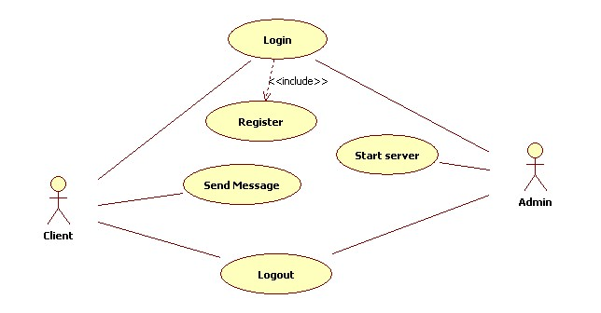
UML Diagram: Use case diagram

Slide 4
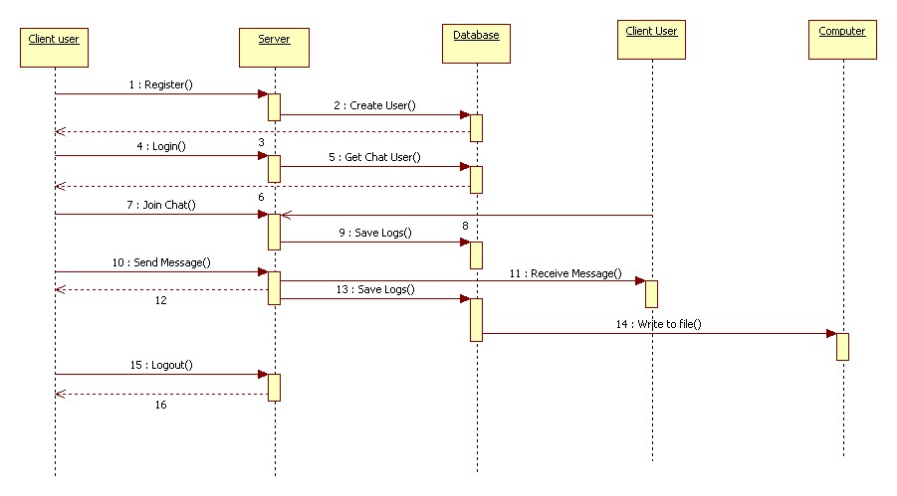
UML Diagram: System sequence diagram

Slide 5
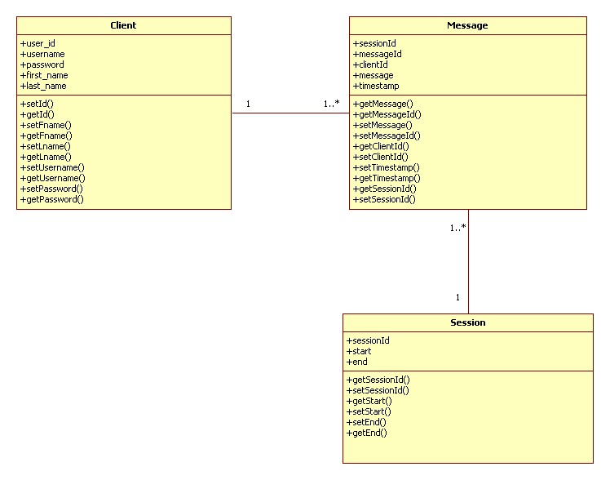
UML diagram: Class diagram

Slide 6
Program
Client may:
Register
Login
After login:
Join chat
Chat begins:
Send message
Receive message
Save logs to database
Save logs to file
View active
Logout
Bye command

Slide 7
Classes
Transaction Classes
Register
Login
Chat
Chat Server
Chat Client
Read Message
Send Message
Base Classes
Message
Session
Client
Default Page
Utility Classes
Database Transaction
Timestamp
File Transaction

